Slide 1


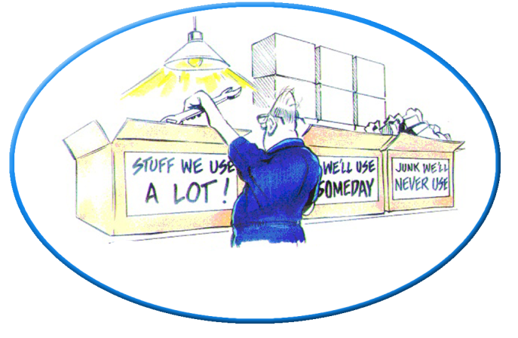
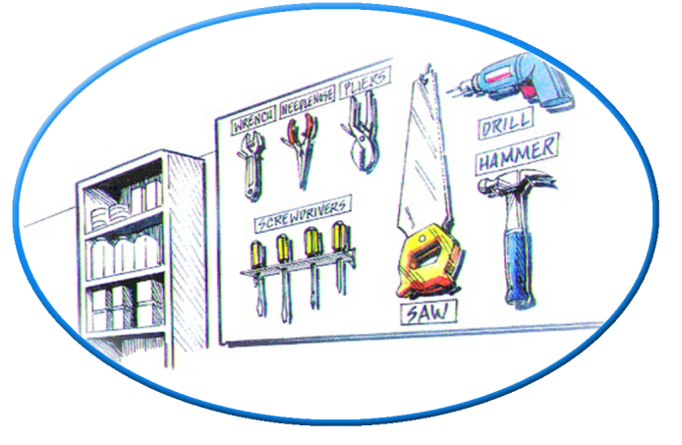
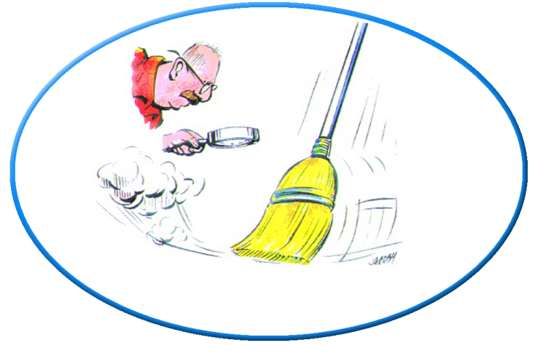

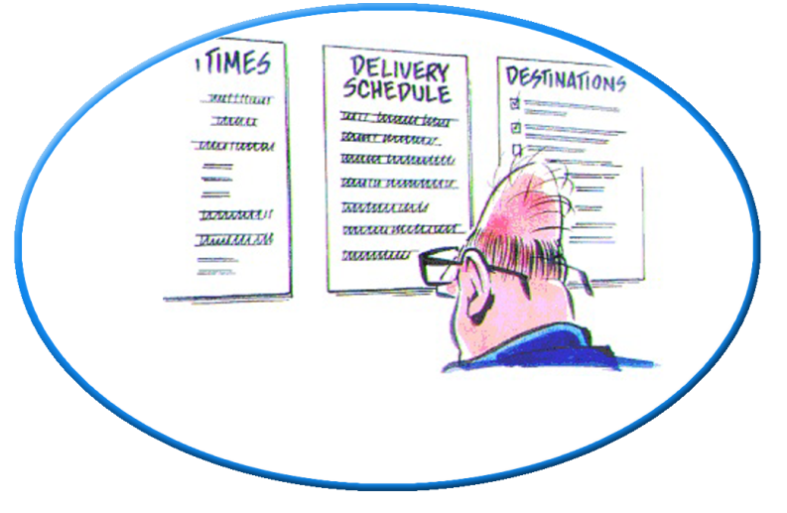
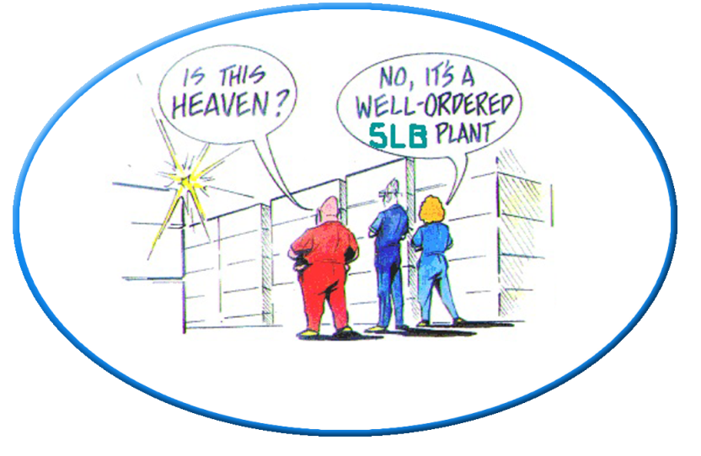
5S
1. Sort
2. Set in Order
3. Shine
4. Standardize
5. Sustain
Notes:
Welcome to Module 15, 5S.
‹#›

Slide 2

Overview of 5S
5S is a method to improve and sustain workplace organization and is the first step to a Lean organization.
The 5S’s are fundamental to continual improvement strategy based on "Lean Thinking" or waste removing concepts.
Notes:
5S is a systematic method to improve and sustain workplace organization. At first glance one might suspect that 5S is only housekeeping and might dismiss the importance of 5S to an organization. However, after taking the time to understand 5S you will realize that it is as much about process productivity, efficiency, effectiveness, and waste removal as it is about housekeeping. You will also realize that 5S is one of the foundation principles of Lean thinking and is a prerequisite or first step for further continuous improvement.

Slide 3

5S Stands for
5S represents
5 disciplines
for maintaining a
visual workplace
Sort
Set in order
Shine
Standardize
Sustain
Notes:
Notes Developed by Donald P. Lynch, Ph.D. - University of Michigan
‹#›
The 5S’s are actual 5 loosely translated Japanese words that provide the discipline for organizing, optimizing, and internalizing order to create a visual workplace.

Slide 4



Benefits of 5S
Reduces the time looking for tools and equipment
Creates pride in the workplace!
Always be “tour ready”
Notes:
Notes Developed by Donald P. Lynch, Ph.D. - University of Michigan
‹#›
One of the side benefits that results in productivity improvements is the time that is saved not looking for tools, equipment, and information. Many companies have a standard that any tool must be able to be found within 60 seconds, does this exist at your current workplace?
It creates a work environment that is always orderly and clean. If time needs to be spent preparing a workplace for a customer or executive visit then the organization has not effectively implemented 5S. The workplace should always be in tour ready condition.
A personal benefit on the soft side of the business is the positive impact on worker morale and pride that stems from a clean, orderly, and efficient workplace. Everyone likes to work in a 5S environment.

Slide 5
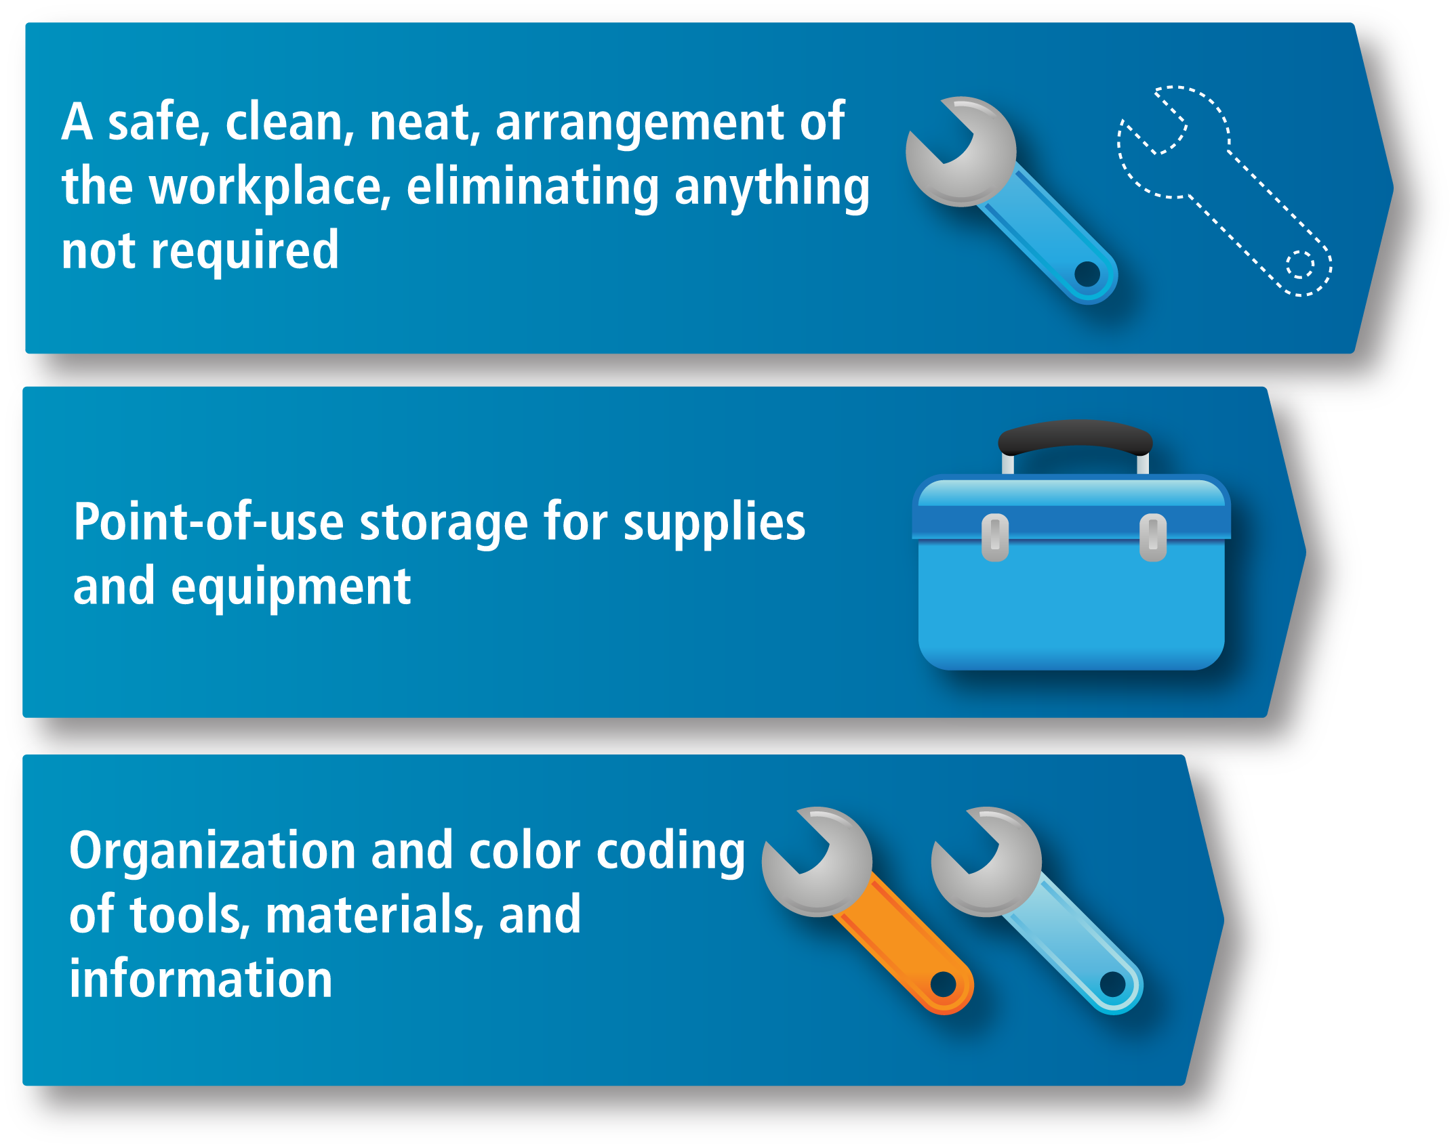
5S - Workplace Organization
“A place for everything and everything in its place!”
Notes:
A slogan for 5S or workplace organization is “a place for everything and everything in its place.” This includes a safe, clean, neat, arrangement of the workplace, eliminating anything that is not required. This also includes point-of-use storage for supplies and equipment. Finally this includes organization and color coding of tools, materials, and information.

Slide 6
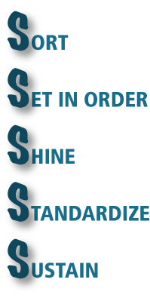
5S - Process
5S is the first step in continuous improvement
It promotes stabilization and variation reduction
Notes:
The 5S’s stand for sort, set in order or organize, shine or clean, standardize, and sustain. 5S is the first step in continuous improvement and is a prerequisite for lean implementation. 5S and standardized work can help to stabilize a process and reduce the variation so that subsequent Lean tools can be used. If there is no workplace organization, it is very difficult to see the flow. As you implement 5S, a significant amount of waste will be eliminated from the system. We certainly want to use the tools that will give us the quickest results with minimal effort. 5S will point to “just go do it” improvement actions that do not require much analysis to uncover.

Slide 7

Sort
What is not needed, sort through, then sort out
“When in doubt,
throw it out!”
Notes:
Notes Developed by Donald P. Lynch, Ph.D. - University of Michigan
‹#›
The first S is sort. This is where we sort what is not needed and remove it from the workplace. Most people save everything for fear that there is a small possibility that they may need it in the future. Protecting for the extreme cases causes excess clutter in the workplace. A rule of thumb is that if you do not touch a tool, piece of equipment, or information within a week of work, it does not belong in the work area. For less frequent access it can be moved to a central area. Seldom-used items can be removed completely. When in doubt, throw it out.

Slide 8
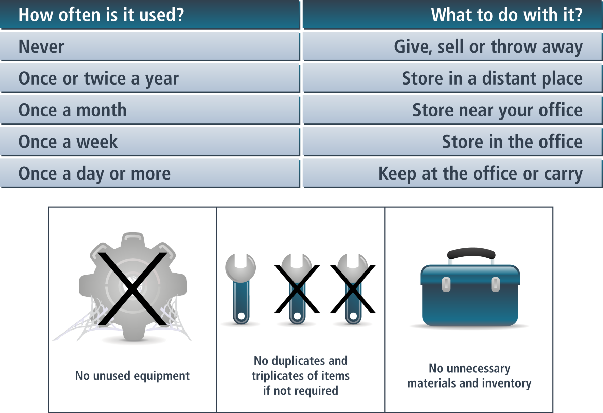
Sort Guidelines
Notes:
Here are some more specific guidelines for sorting a workplace. A good way to decide where to store things is to determine how often each item is used. Give, sell, or throw away items that are never used. Keep things where they will be accessible when needed but not where they take up space that could be used for something else. Depending on how often you need the items, you could store them in a distant place or store them near or in your workplace. Keep items that you use daily at the workplace or carry them with you. Sometimes we give special value to things that we decide to put in the cabinets in our workplace for future use, but usually they are not used or you can’t find them when you want to use them.

Slide 9

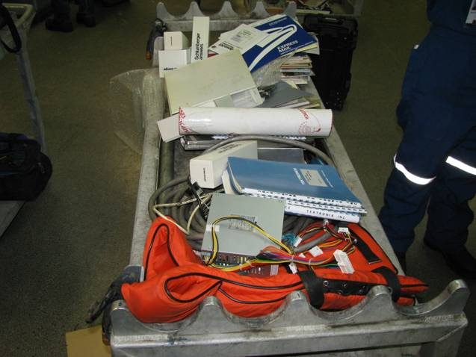
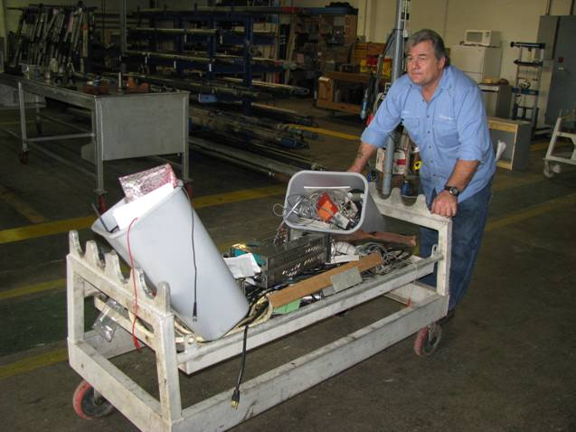
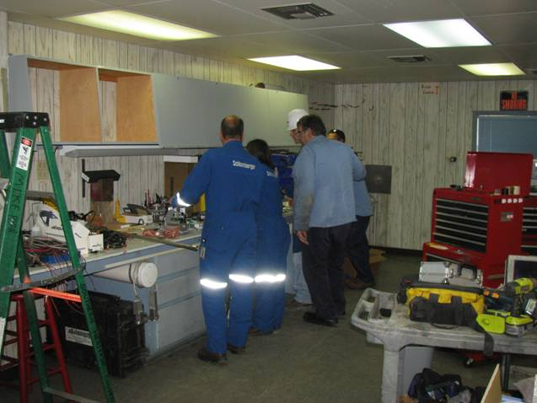
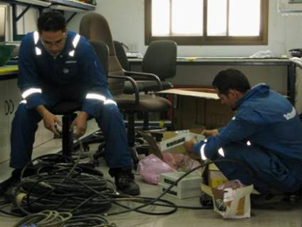
Sort Examples
Notes:
This slide shows some pictures of employees sorting the workplace in a the middle of a 5S campaign.

Slide 10

Set in Order
Make what must be kept visible and self-explanatory
Notes:
Notes Developed by Donald P. Lynch, Ph.D. - University of Michigan
‹#›
The next S is set in order. A more accurate translation may be to organize or straighten. What is left from the sort process must be organized or set in order in a places that are visible and logical within easy reach of the person in the process. At a maximum, is should take no longer than 60 second to locate anything used within the process. In addition, the organization of the workplace should be visual. Anyone who walks into the workplace should be able to determine visually if a tool or piece of equipment is missing from the process.

Slide 11

Set in Order Guidelines
Optimize layout
Physically reconfigure the area
Review layout and revise
Mark locations for equipment
Assign location for tools and accessories
Label locations
Build racks or shadow boards for frequently used items
Place heavily used items near primary work locations
Notes:
Here are some tips to help you when setting in order or straightening.
Plan an optimum layout for the selected area.
Physically reconfigure the area to match the planned layout.
After reviewing the new layout, make any revisions that will improve it.
Use floor tape to mark the new locations for all equipment, racks, production materials, etc., as well as aisles. Use visual management tools to identify the proper locations.
Determine the best locations for tools, gauges, work aids, and other small items.
Mark and label these locations.
Build racks or shadow boards for frequently used items.
Move items close to their points of use, and ensure that heavily used items are placed near primary work locations while less used items are placed further away.

Slide 12
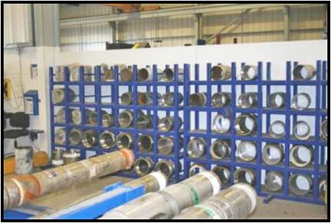
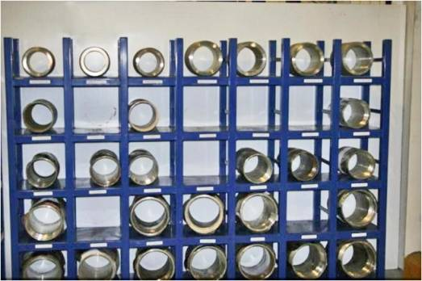
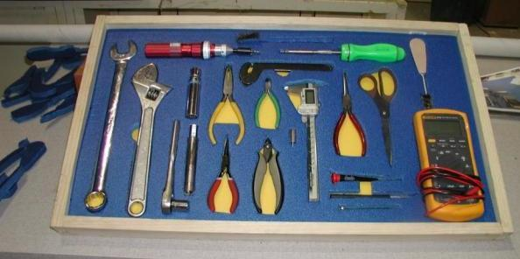
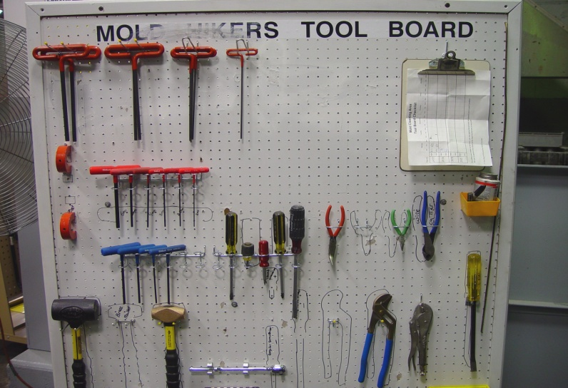
Set in Order Examples
Before
After
After: parts have been labeled for ease of use and unneeded parts have been removed, reducing rack space by 1/3 with no parts on the floor
Before
After
Organize and place items in easy to reach locations to reduce retrieval time
Notes:
This slide shows some examples of set in order. The pre-formed cases and shadow board are excellent for set in order that is very visual. It is easy to see exactly what is required in the workplace and it is very apparent when something is missing. If an operator from the next shift to comes to the work area they will be able to tell immediately if a tool is missing. They should be able to find and replace it before it is needed in the middle of an operation. In addition, when we get to sustain, it is very easy to gauge the conformance to the principles of 5S using this type of a solution.

Slide 13

Shine
Clean equipment and work spaces
Notes:
Notes Developed by Donald P. Lynch, Ph.D. - University of Michigan
‹#›
The next S is shine or clean the equipment and work spaces. First, we sort to remove any unneeded items from the workplace. We do not want to spend the time to clean something that we plan to remove. Cleaning is not only about having a nice work environment, it is about being able to determine when a non-standard condition exist such as missing equipment, poor quality connections, excess wear, cracks, and leaks. With 5S it becomes much easier to perform a thorough inspection of the process. Faults are easier to find in a clean workplace. For example, if a work area is dirty or greasy, it may be difficult to determine if there is an oil leak on a piece of equipment. Cleanliness also is a direct reflection on the organization in the eyes of customers, executives, and others. If an organization does not have the discipline to keep the work area clean, a customer may conclude, how can they be trusted in other business matters?

Slide 14


Shine Guidelines
Completely clean the entire area selected for 5S implementation, including floors, walls, all items and equipment
Tag and repair leaks, broken dust guards, etc. that could cause future cleanliness problem
Paint or refinish areas if necessary, and replace broken components
Provide proper cleaning tools to maintain the improved condition
Ensure that proper collection methods exist for work debris and trash
Faults Are Easier to Find in a Clean Environnent
Missing equipment
Poor quality connections
Excess wear
Cracks
Leaks, etc.
Notes:
This slide outlines a very detailed procedure for cleaning the workplace.
First, completely clean the entire area selected for 5S implementation, including floors, walls, all items and equipment etc. Completely clean all items and all equipment in the area. Tag any leaks, broken dust guards, etc. that could cause a future problem. Repair tagged items. Paint or refinish areas if necessary, and replace any broken components. Ensure that the proper cleaning tools are present to maintain the improved condition and that proper collection methods exist for work debris and trash.
Faults are easier to find in a clean environment. Some of the things you can look for include missing equipment, poor quality connections, excess wear, cracks, leaks, and other problems.

Slide 15
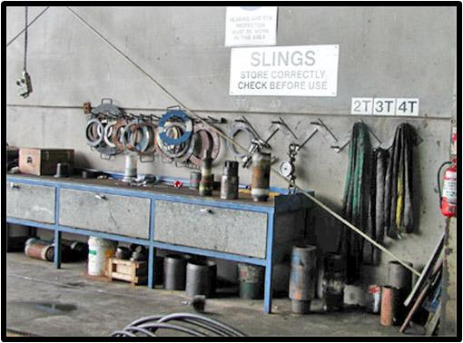
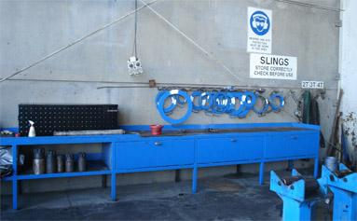
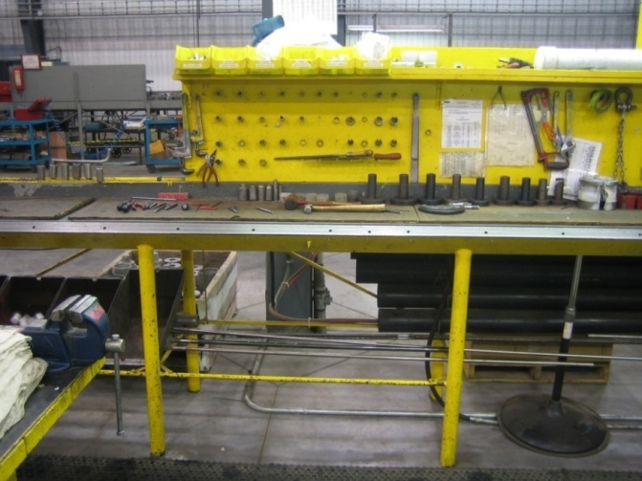
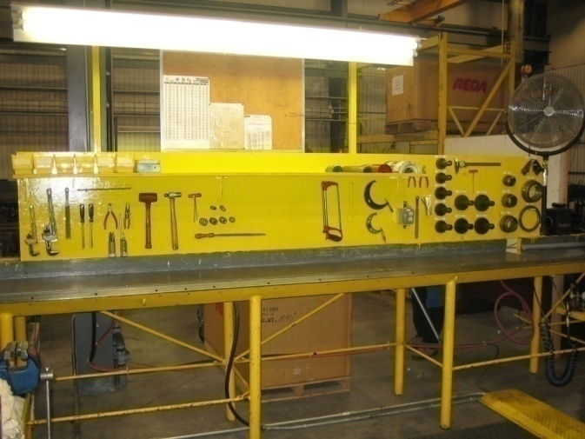
Shine Examples
Before
After
Notes:
Here are some examples of shine from the workplace. Notice the cleanliness of the work spaces, tools, and floors. Also notice the new paint.

Slide 16

Standardize
Set standards for the first 3S’s:
Sort
Set in Order
Shine
Notes:
Notes Developed by Donald P. Lynch, Ph.D. - University of Michigan
‹#›
The next S is standardize. This is where we use standardized work to establish procedures for the first three S’s. The standards will help in the next phase, sustain, and will serve as a reference for the team to internalize the 5S results.

Slide 17

Standardize Guidelines
Decide what needs to be done regularly to maintain
Decide the frequency: daily, weekly, monthly, or semiannually
Make a “Standardize” checklist
Decide who should be responsible for each checklist
Incorporate the checklists into the standard job requirements
Notes:
In standardization, we need to decide what needs to be done on a regular basis to maintain the results obtained from the 5S effort and the frequency. Make a “Standardize” checklist that details all of the 5S results in each of the first three S’s and decide who should be responsible for each checklist. Finally, incorporate the checklists into the standard job requirements.
Standardization is imperative to ensure that the gains from the 5S effort are sustained. It is also important to internalize the results until they become habitual. Standardization can be used as a training mechanism for new employees and as a reminder for veterans.

Slide 18
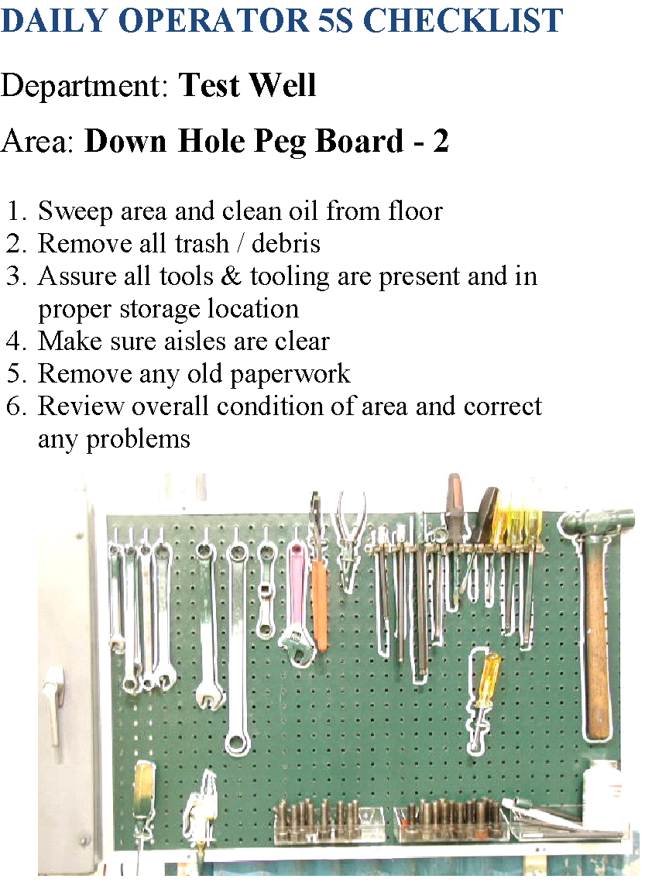
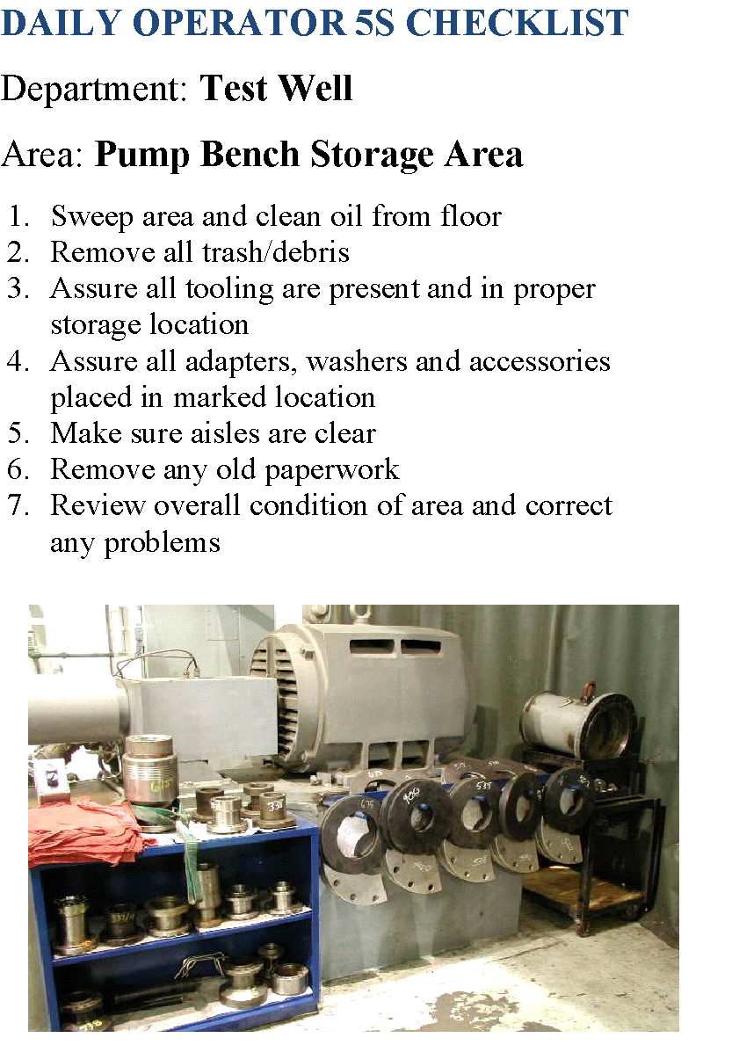
Examples of Standardize Checklists
Notes:
Here are some standard checklists from the work area that outline what needs to be done on a daily basis.

Slide 19

Sustain
Requires discipline, stick to the rules and make them a habit
Notes:
Notes Developed by Donald P. Lynch, Ph.D. - University of Michigan
‹#›
The final S is sustain. This is the hardest part of the process but it helps us ensure that the improvements we make are internalized and that any new actions become a habit. Sustain usually starts with some sort of audit system that remains in place until the new situation becomes commonplace. This type of discipline does not develop automatically in an organization. It must be practiced. The sustain phase of our work ensures that the discipline remains in place.

Slide 20

Sustain Guidelines
Use the 5S audit sheet
Divide areas of responsibility
Supervisors/managers responsible for regular 5S audits
Chart and post the data from the audit system regularly
5S Assessment Form Will be shared in googlesheets
Notes:
In sustain we will use a 5S audit sheet in each area after a 5S campaign. We need to divide areas of responsibility. Usually, supervisors and managers are responsible for regular 5S audits in which they audit each other's areas. After the audits we regularly chart and post the data from the audit system. Many times we will express the results in a radar chart with each of the 5S's on the axis of the radar chart. This chart allows us to see easily where there may be gaps in our deployment and those that need reinforcement.
The 5S assessment form is available from the Lean website.

Slide 21
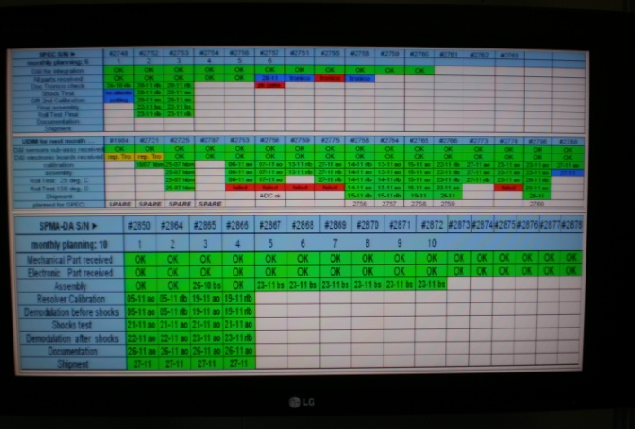
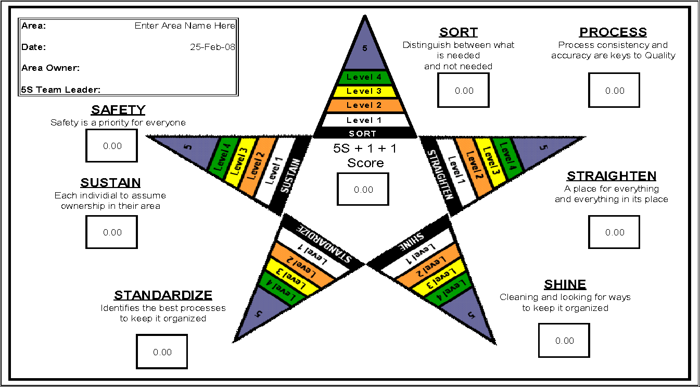
Sustain Results
Daily tracking on LCD screen
Notes:
An even more effective visual system to is display the daily results on a LCD screen. This method allows everyone in the organization to see the results and 5S performance real time, creating a bit of internal competition and peer pressure.

Slide 22



Getting Started – Team
Identify a
5S Leader
Form an
Implementation
Team
Introduce
Employees
to 5S
Notes:
Notes Developed by Donald P. Lynch, Ph.D. - University of Michigan
‹#›
To start a 5S campaign in a particular area, first you need to identify a leader.
Next, you need to form an implementation team. This team should be made up of people who will be working in the specific workplace. It is important to get a good cross section of the people in the process not only to obtain the best insight, but to ensure that any changes that are implemented are well received. It is important that the team feels that they have ownership in the solution.
The next step is to offer some overview training to the team on the 5S methodology (such as this online training) before they begin the process.

Slide 23

Getting Started – Project Selection
Identify a Project
Start with an easy project
Empower employees
Take “before” and “after” photos
Champion provides guidance
Develop and post a “standardize” checklist
Notes:
10/20/2018
‹#›
To begin a 5S campaign, first identify an easy project to gain a quick win and generate some confidence and enthusiasm. Make sure to empower employees to gain their support. It is a good idea to take “before” and “after” photos of the same work area so you can truly compare the differences. You will be amazed by the change. The pictures are also a good mechanism for generating some excitement for the Lean effort. A champion should be selected to provides guidance. Finally, it is a good idea to develop and post a “standardize” checklist from the standardize phase.

Slide 24

How to Get Started – Start
Divide large locations into areas, each with a leader
Develop implementation schedule
Prioritize and perform 5S activities
Develop audit schedule
Perform scheduled audits of area
Record and post the results
Enter all 5S audits into the audit score sheet shared in googlesheets
Focus on continuous improvement
Provide team recognition
Notes:
For an organization-wide deployment of 5S you should divide large locations into areas, each with a leader. The leader should develop an implementation schedule and an audit schedule.
Next the team should perform the work to make the changes, scheduled audits of the area, and record and post the results. Enter all 5S audits into QUEST as an “Inspection-other” and attach the audit score sheet. Focus on continuous improvement and provide team recognition.

Slide 25
Download 5S Forms
The 5S Excel Checklist will be shared in googlesheets
Notes:
Download a form for a 5S action item list and a 5S assessment form by clicking on the Attachments tab.

Slide 26

Summary
5S Principles
Workplace organization is the first step in continuous improvement
Get everyone involved
Audit on a regular basis
Monitor using visual management
Sort – Set in Order – Shine – Standardize – Sustain
Notes:
When fully implemented, the 5S process increases efficiency and organization, increases morale, and makes positive impressions on customers. Not only will employees feel better about where they work, the effect on continuous improvement can lead to less waste, better quality, and faster lead times. 5S is not only a system for housekeeping, it is an integrated approach for productivity improvement. It is a culture that increases production, improves quality, reduces cost, makes deliveries on time, improves safety and morale.
5S is not a list of action items, but is an integrated concept of actions, conditions, and culture. To get the greatest success, the nature and implication of each "S" needs to be understood by each employee and should be regularly practiced. 5S and workplace organization is the first step in continuous improvement. It is critical to get everyone involved, audit on a regular basis, and monitor using visual management.
This concludes

